Slide 1
Emerging themes in infectious disease modelling
Steven Riley
These Slides at https://goo.gl/zCwwFU

Slide 2
OBJECTIVES
At the end of this session, you should be able to:
Explain the key difference between a mathematical transmission model and other statistical models of disease incidence
Describe a framework for the critical evaluation of a evidence derived from a model
Outline the thematic directions of the field in terms of questions addressed and methods used
Describe specific examples of interesting papers from different themes

Slide 3
OVERVIEW
What is an infectious disease model?
What is a good model?
An overview of themes
Outbreaks
Global Health
Use of genetic data
Discussion

Slide 4
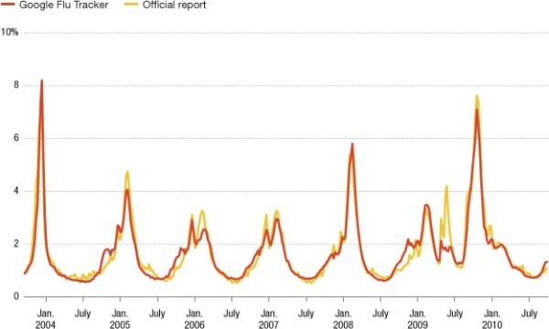
RISK OF INFECTION VARIES OVER TIME
Force-of-infection is the risk of infection experienced by a
single susceptible individual at a point in time

Slide 5
OVERVIEW
What is an infectious disease model?
What is a good model?
An overview of themes
Outbreaks
Global Health
Use of genetic data
Discussion

Slide 6
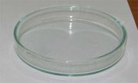
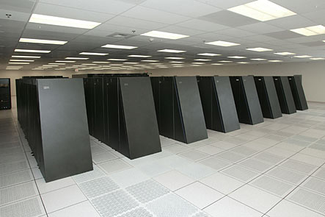
WHAT MAKES A MATHEMATICAL MODEL SPECIAL?
in vitro
A “typical” investigation
Formulate hypothesis
Construct model
Run experiment
Analyze results
Interpret results as evidence for or against hypothesis
Critique model structure in light of main findings
in silico
NOTHING!!!

Slide 7
BUT YOU MIGHT GET ASKED TO MAKE A QUANTITATIVE PREDICTION?
Lots of reasons, but consider the following example…
You are on a TV quiz show
Random child picked from the audience but you can’t see them
You are told that its a 23 month old girl
If you guess their height in cm exactly, you win a house in Belgravia
Would you use a model?
Would it be right?
Notes:
‹#›

Slide 8

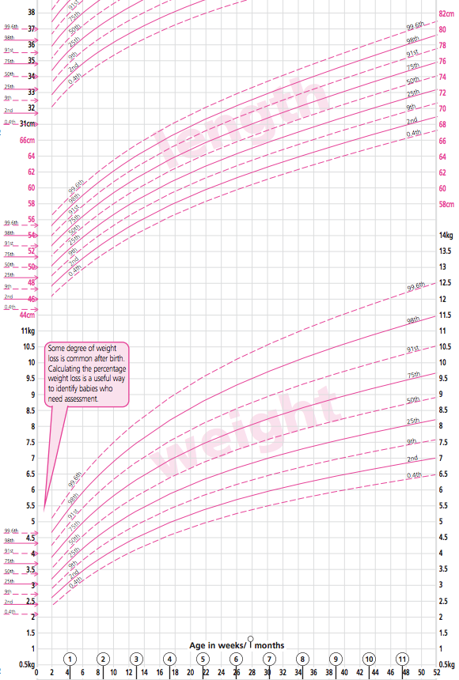
AN OPTIMAL MODEL?
Source: www.rcpch.ac.uk

Slide 9
QUESTIONS TO HAVE IN MIND ABOUT MODELLING PAPERS
What questions is the paper addressing (Question)?
What are the key results (Results)?
Criticism of model structure (Methods)?
How well were data used (Data)?
Are the claims interesting/important and supported (Overall)?
Assess structure and relationship to data to rate overall quality of evidence relative to specific claims

Slide 10
OVERVIEW
What is an infectious disease model?
What is a good model?
An overview of themes
Outbreaks
Global Health
Use of genetic data
Discussion

Slide 11
OVERVIEW OF THEMES
Questions
Outbreaks
Global health decision making
Population science
Within-host science
Evolution
Methods
Use of genetic data
Use of spatial data
Data synthesis
Pathogens
Big 3
Emerging infections
NTDs
Influenza / Respiratory infections
STIs

Slide 12
OVERVIEW
What is an infectious disease model?
What is a good model?
An overview of themes
Outbreaks
Global Health
Use of genetic data
Discussion

Slide 13
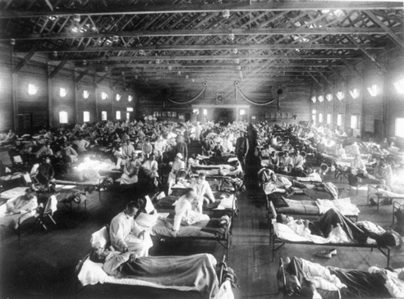
UNUSED SLIDES
steven.riley@hku.hk
Notes:
‹#›

Slide 14

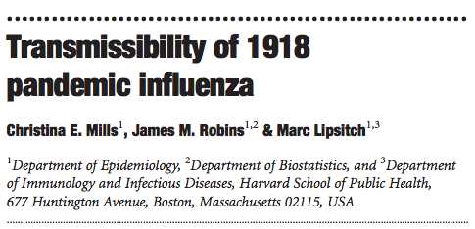

Slide 15
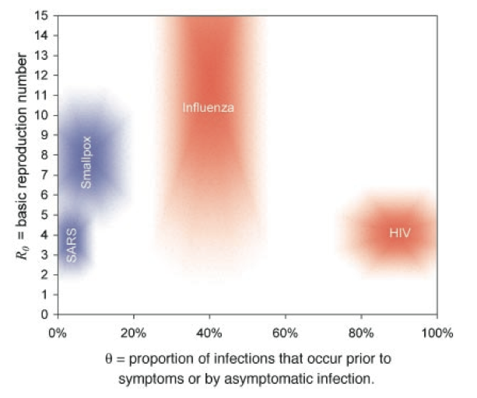
QUESTION: WHAT IS R0 FOR FLU
Source: Fraser et al, PNAS, 2004

Slide 16
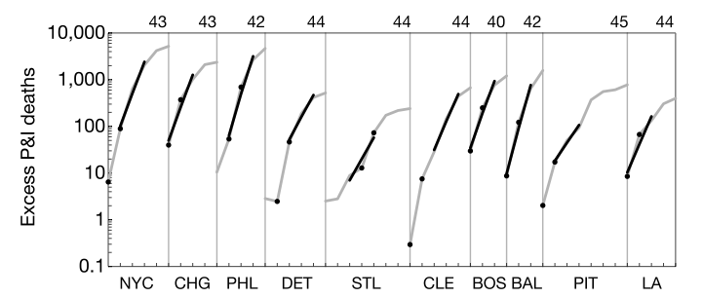
GOOD DATA WERE USED
Source: Mills et al, Nature, 2004

Slide 17
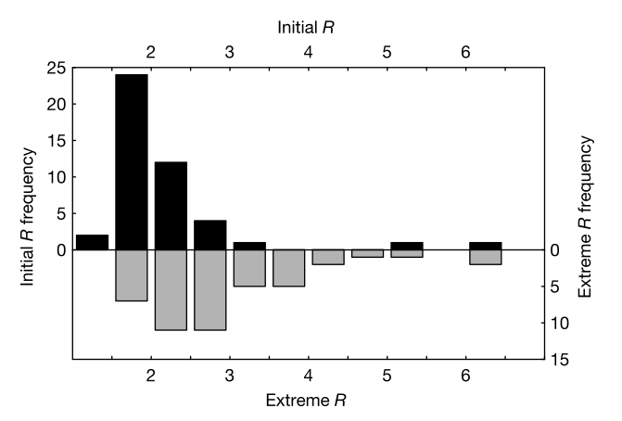
RESULTS
Source: Mills et al, Nature, 2004

Slide 18
OVERALL
Important clear question
Very straightforward methods
Could have considered households and space
Still able to consider a number of sensitivities
Answer seemed robust (notwithstanding serial interval issues)
Very useful paper

Slide 19
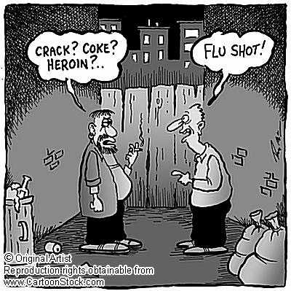
steven.riley@hku.hk
Notes:
‹#›

Slide 20
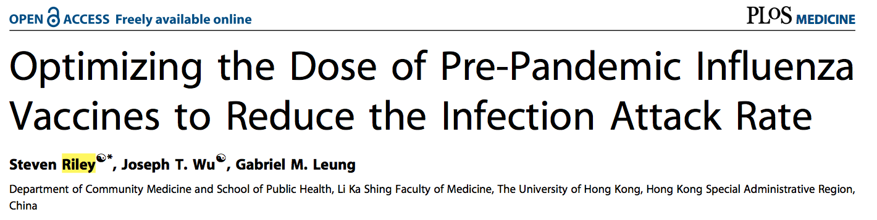

Slide 21
QUESTION
Should dose sparing be used during vaccination campaigns in a moderate or severe pandemic?
Source: Riley et al, PLoS Med, 2007

Slide 22
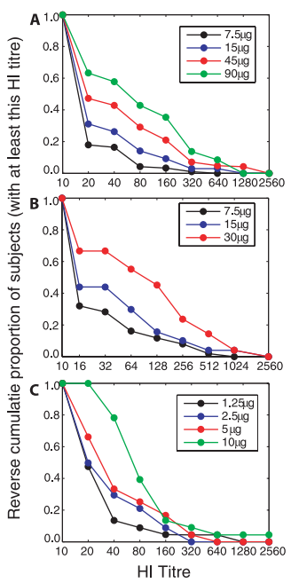
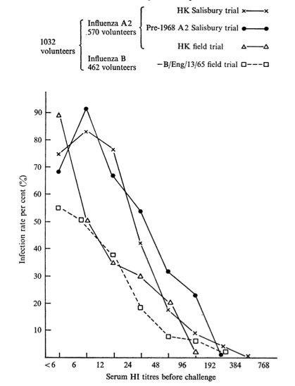
DATA
Sources: Riley et al, PLoS Med, 2007; Hobson et al, 1972, J Hyg

Slide 23
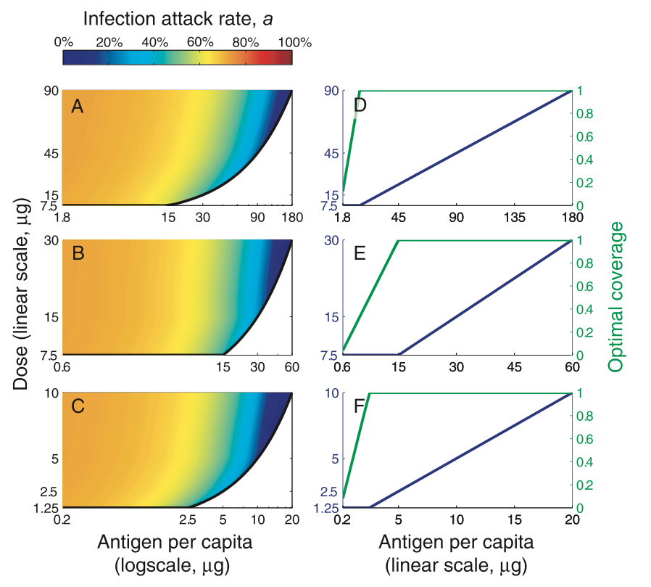
RESULTS
Source: Riley et al, PLoS Med, 2007

Slide 24
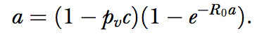
METHODS
Extended to include:
Age groups
HI groups
Relationship between HI and protection
Leaky versus all-or-nothing vaccine effect
High transmissibility sub group
Source: Riley et al, PLoS Med, 2007

Slide 25
FLU DOSE SPARING
Very clear question with direct policy implication
Relatively simple approach, but a number of potential complexities were considered
Data that were available were well used
Firm conclusion difficult
Would these results actually support the use of dose sparing or are additional trials required?

Slide 26
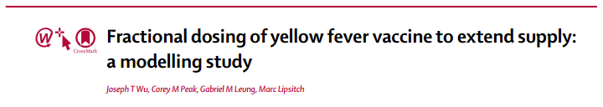
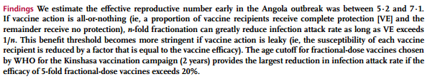

Slide 27
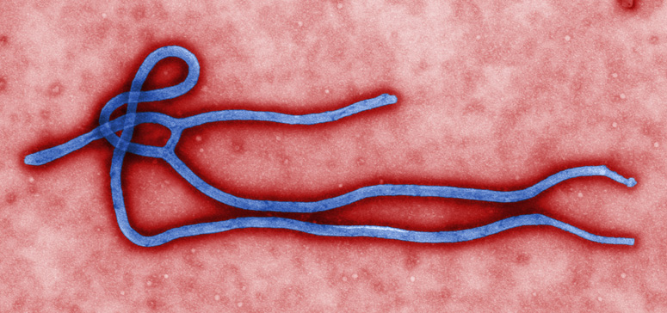
Ebola
Filovirus – one of five Ebola viruses (Zaire, Sudan, Tai Forest Bundibugyo, and Reston ebolavirus)
First discovered in 1976 in Yambuku DRC (formerly Zaire) and Nzara Sudan
Most outbreaks have occurred in remote areas of central Africa and have been limited in size
Reservoir actively investigated since the mid-70s and believed to be the fruit bat
Several species of non-human primates are known to be vectors
Transmission
Zoonotic source and secondary human-to-human transmission
Human-to-human transmission occurs through exposure to infectious bodily fluids namely through the care of infected patients and in the preparation of burial among fatal EVD patients

Slide 28
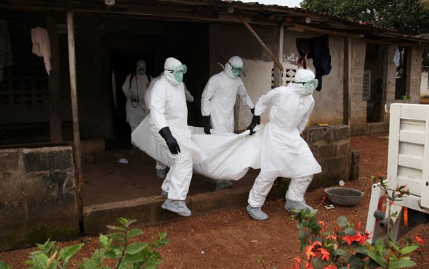
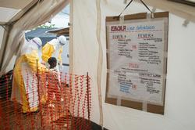
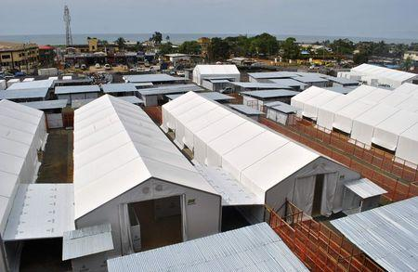
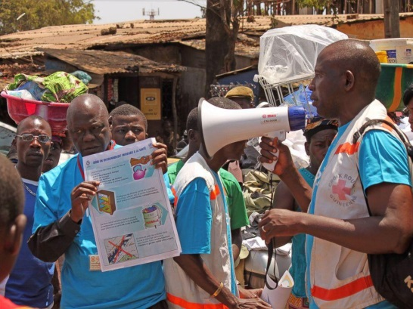
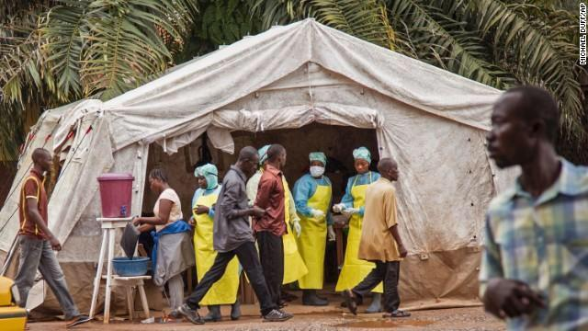
Controlling Ebola
Identifying, isolation and treating patients
Contact tracing
Safe and dignified burials
Limited medical interventions – mainly rehydration and supportive care
Psychosocial care, social mobilization and risk communication are critically important
Notes:
‹#›

Slide 29
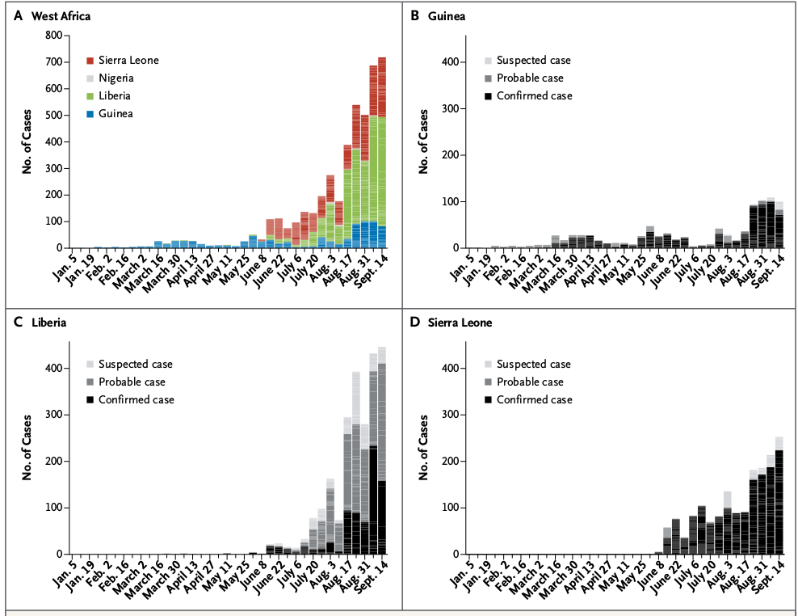
Incidence (confirmed/probable/suspected)

Slide 30
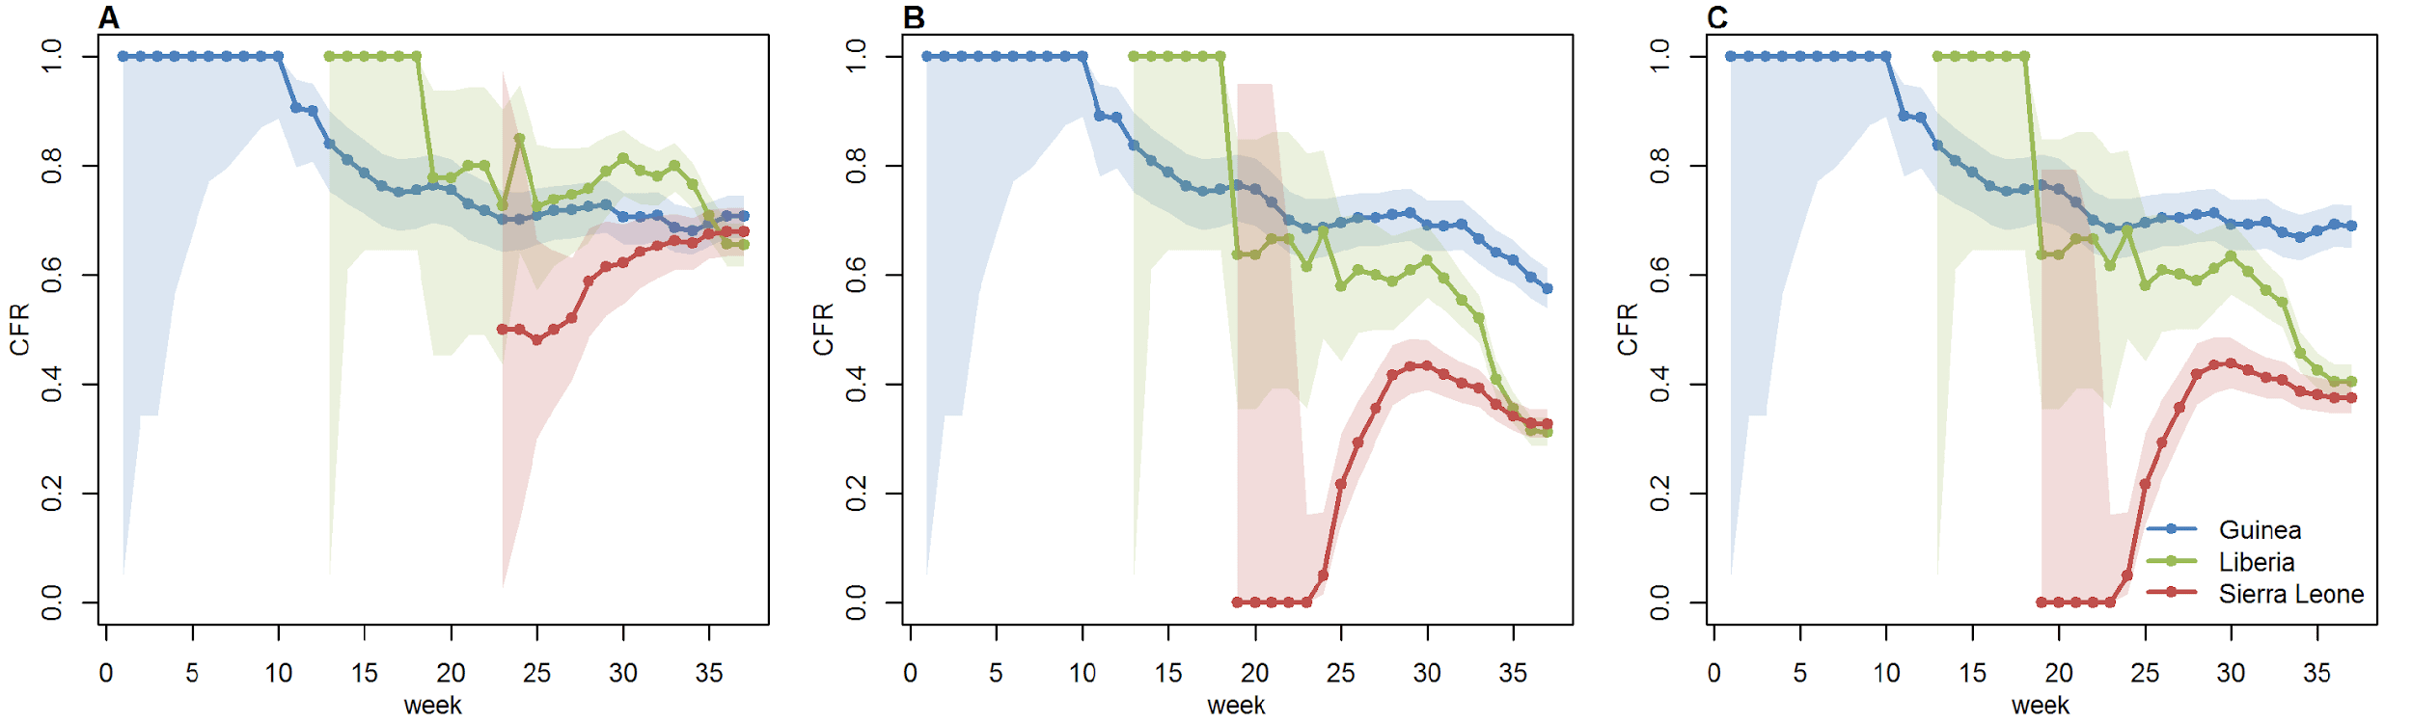
Severity
Naïve estimates (deaths/cases) give relatively low overall CFR=38% (36-39)
Substantial apparent variation between countries
But only 46% of cases have definitive clinical outcome recorded
Only analysing cases with clinical outcome gives CFR=71% (68-73), little variation between countries
No evidence of significant temporal trends other than early bias towards recording severe cases in Guinea
naive
final outcome
Notes:
‹#›

Slide 31
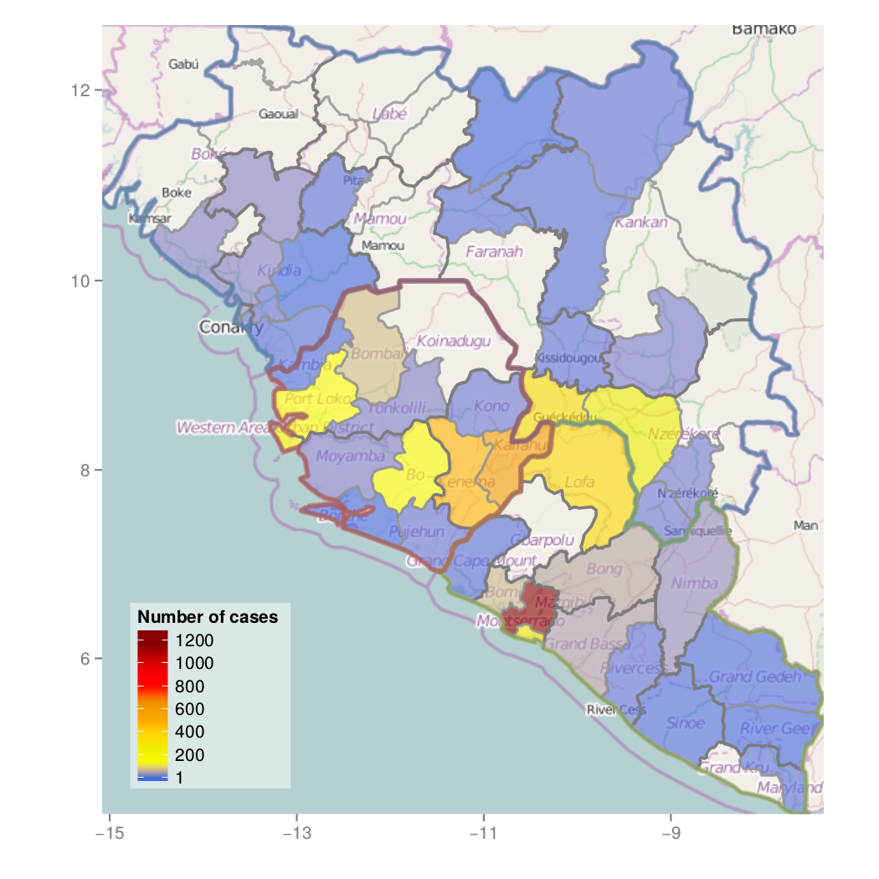
Geographic distribution

Slide 32
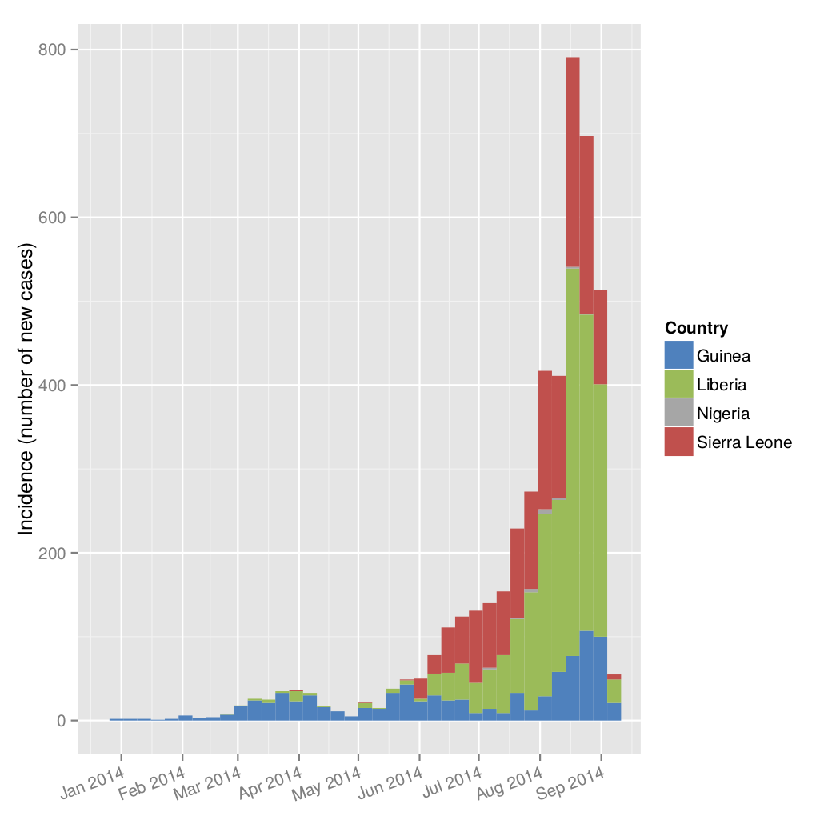
Data challenges
Under-ascertainment: hard to estimate
Reporting delays:
onset → notification to WHO
notification to WHO → line list
Data imputation:
for missing onset date, 'district', etc.
Data cleaning:
current R script >2,500 lines of code; automated where possible, but limits (e.g. >850 hospital 'names' needing manual cleaning)

Slide 33
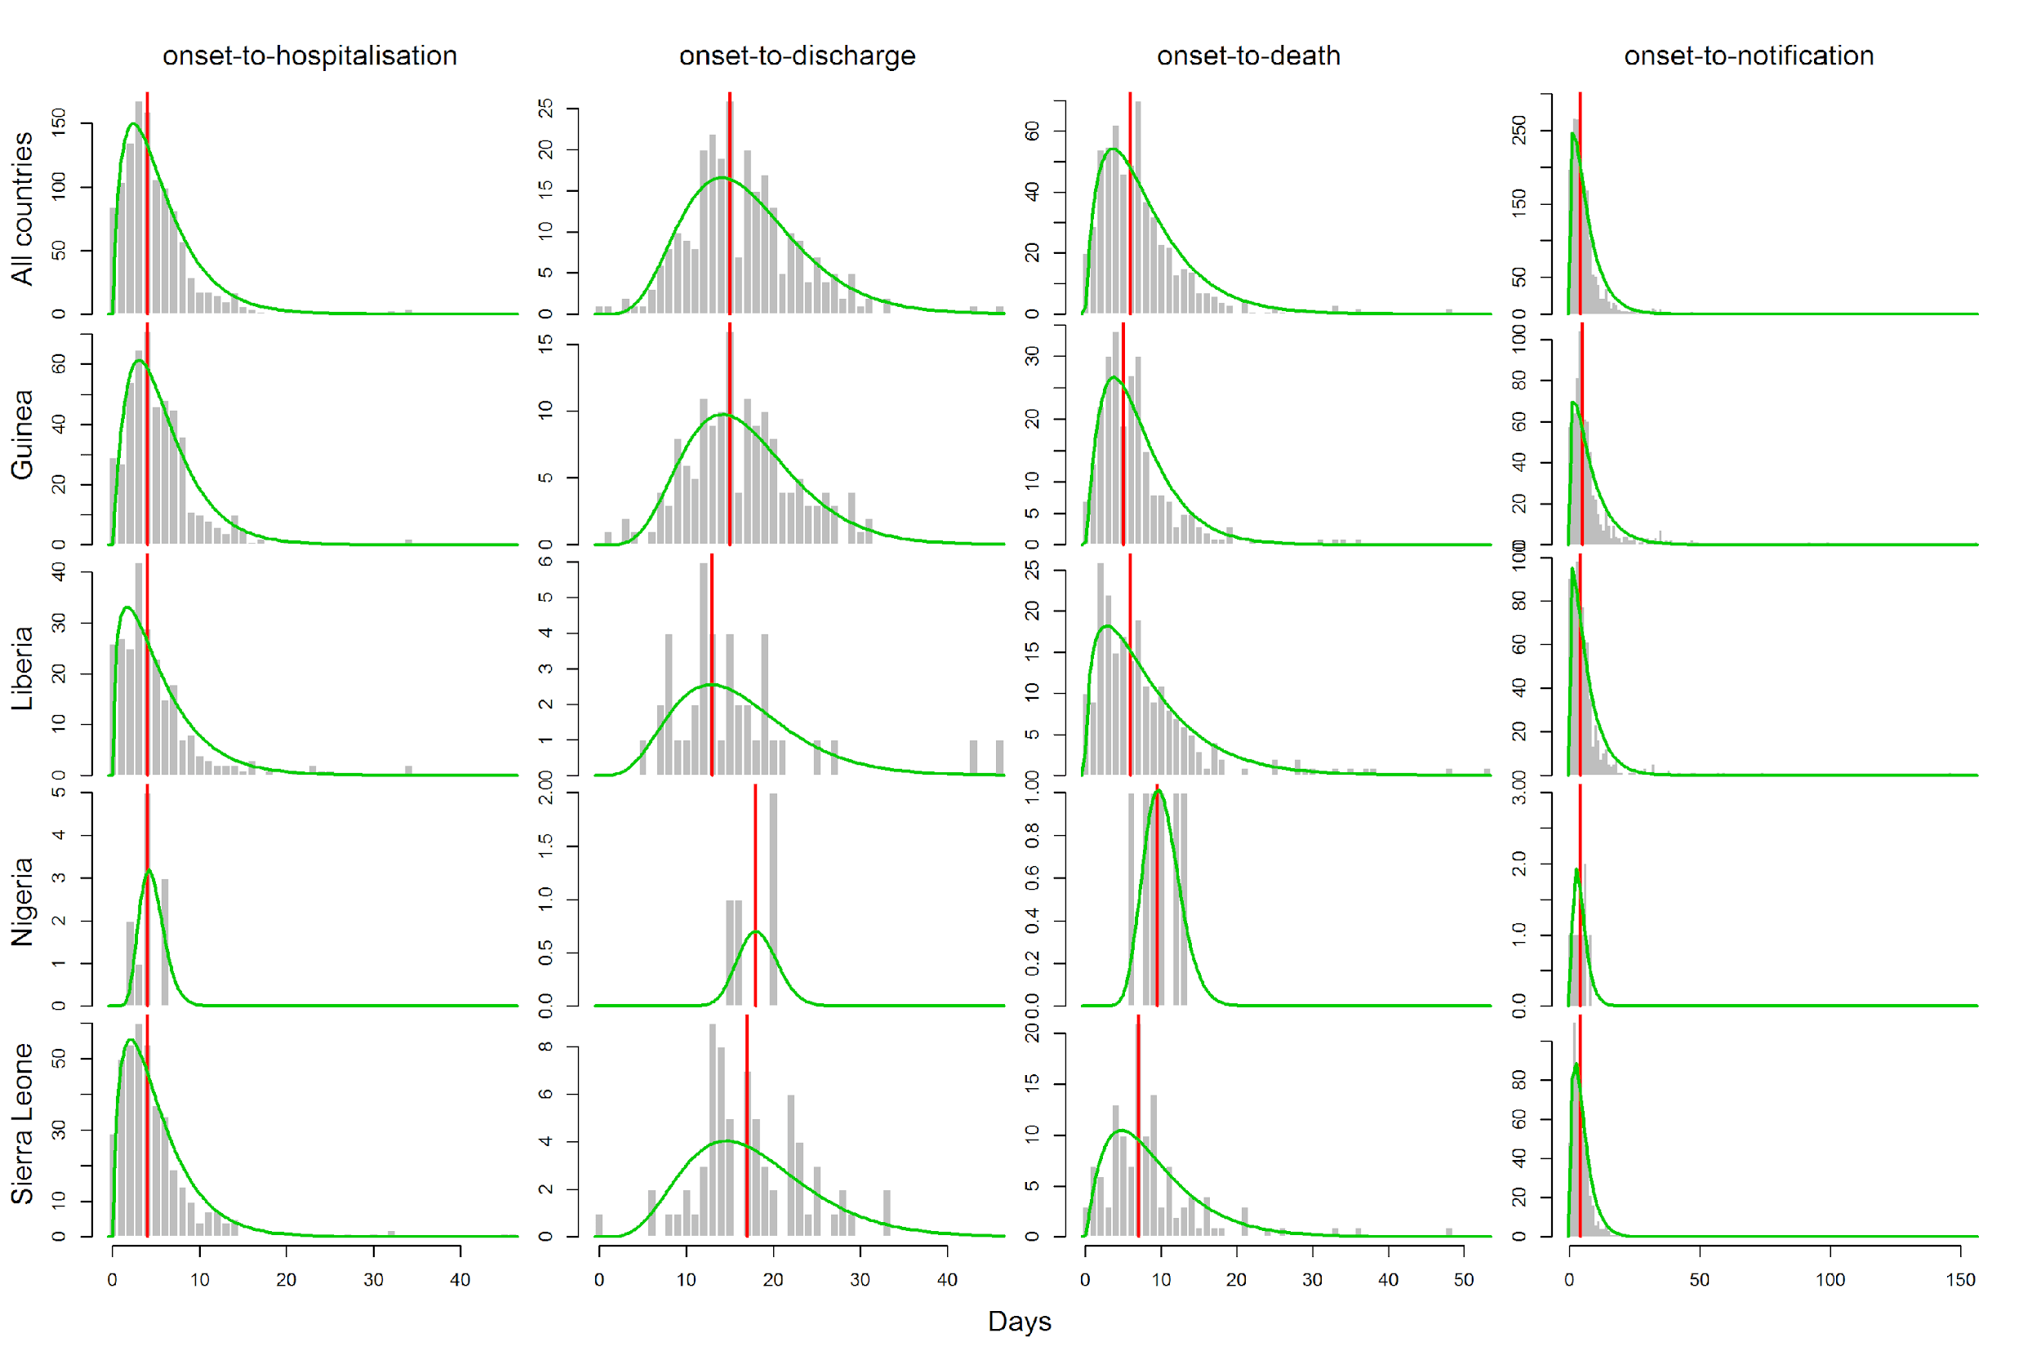
Delay distributions
Notes:
‹#›

Slide 34
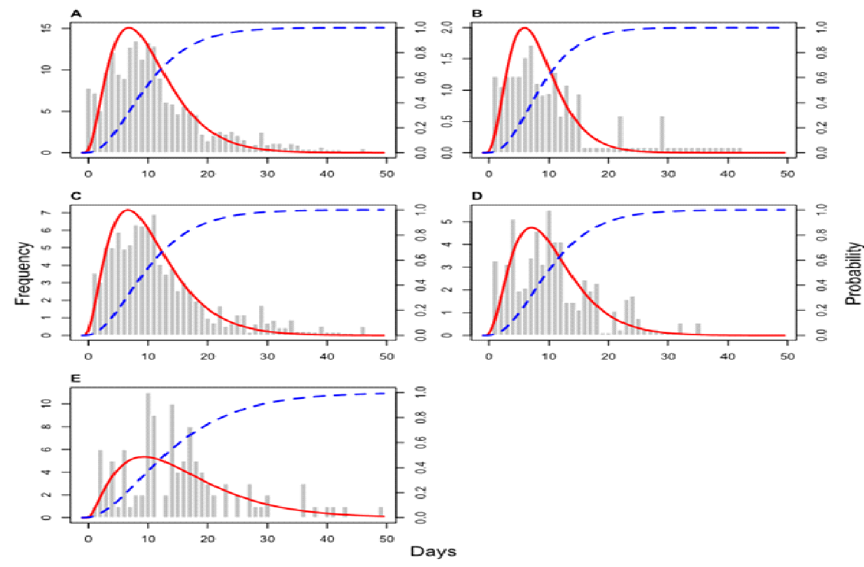
Incubation period
Incubation period, serial interval distributions key to quantifying transmission intensity, assessing control measures
During exponentially growing phase of the epidemic: more recent than older contacts
Incubation period estimates will be biased toward shorter periods
Additional bias towards reporting most recent contacts
All Guinea
Liberia Sierra Leone
Days
Best parametric estimate of IPD:
mean=9.7 days, SD=5.5 days
Notes:
‹#›

Slide 35
Questions related to transmissibility
Is the current virus more/less transmissible than previous Ebola viruses?
How quickly is the virus currently spreading?
What is the projected incidence for next few weeks?

Slide 36
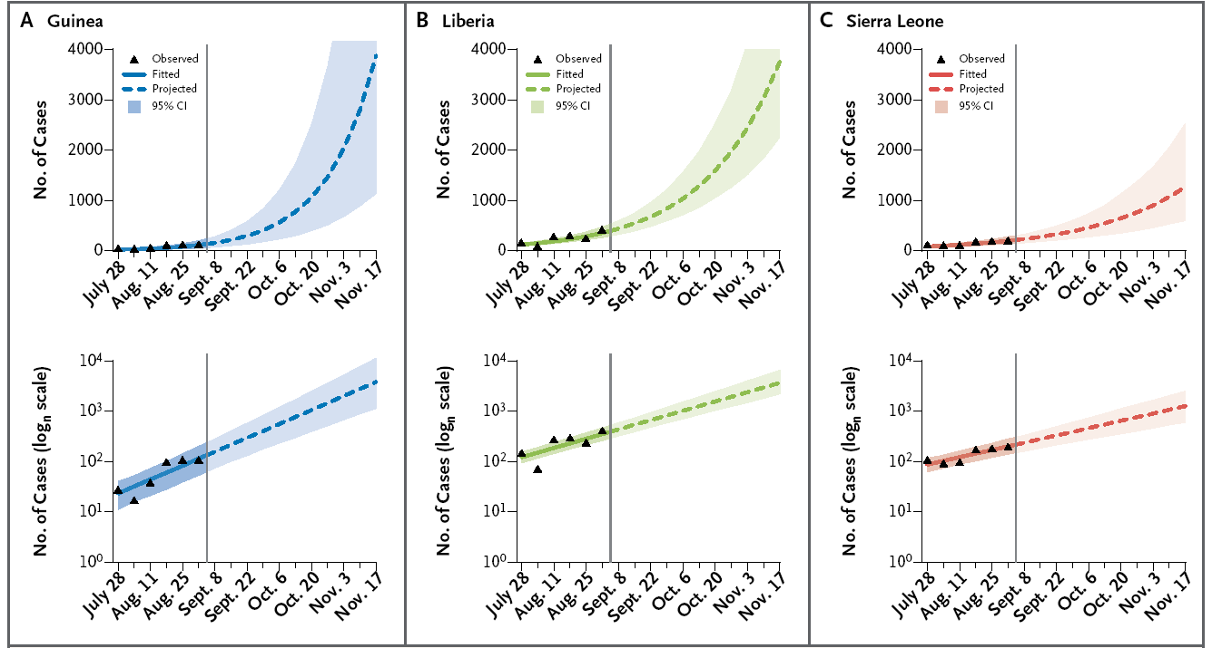
Projections

Slide 37
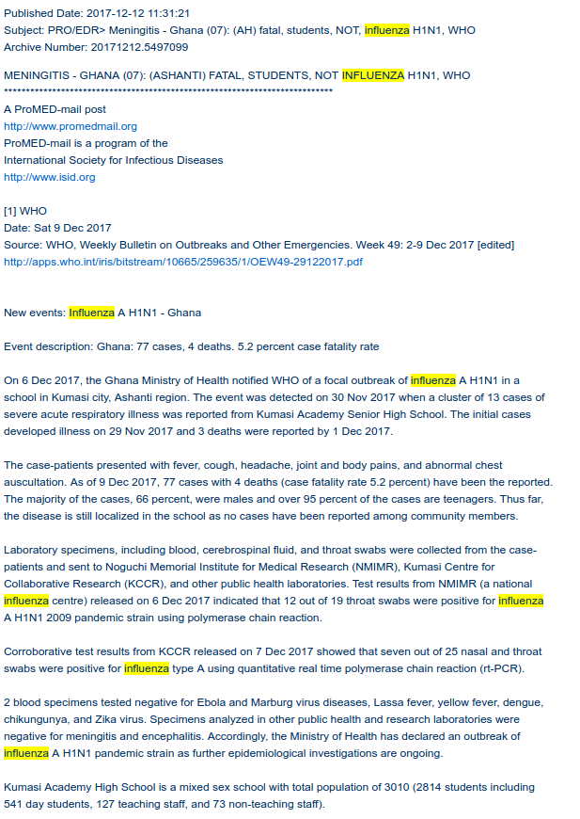
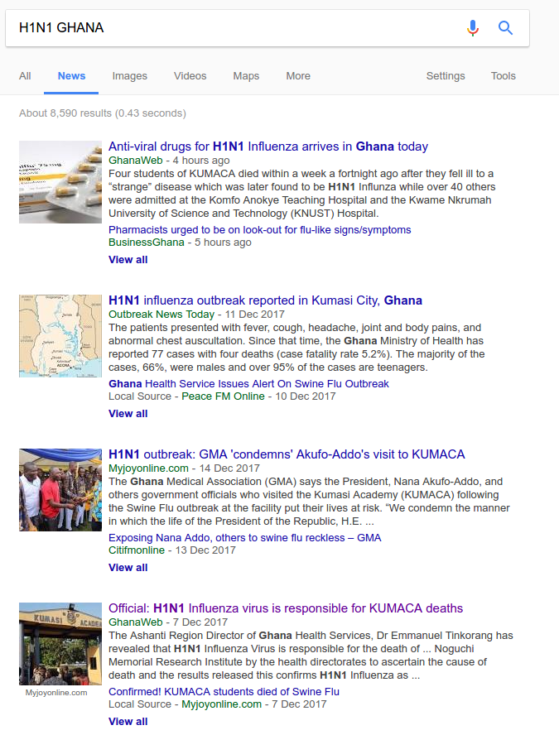
CURRENT CLUSTER OF H1N1 GHANA?
77 cases, 4 deaths
13 cases of SARI
12 out of 19 swabs +ve for pH1N1 with PCR
Fatal cases negative for meningitis and encephalitis

Slide 38
OVERVIEW
What is an infectious disease model?
What is a good model?
An overview of themes
Outbreaks
Global Health
Use of genetic data
Discussion

Slide 39
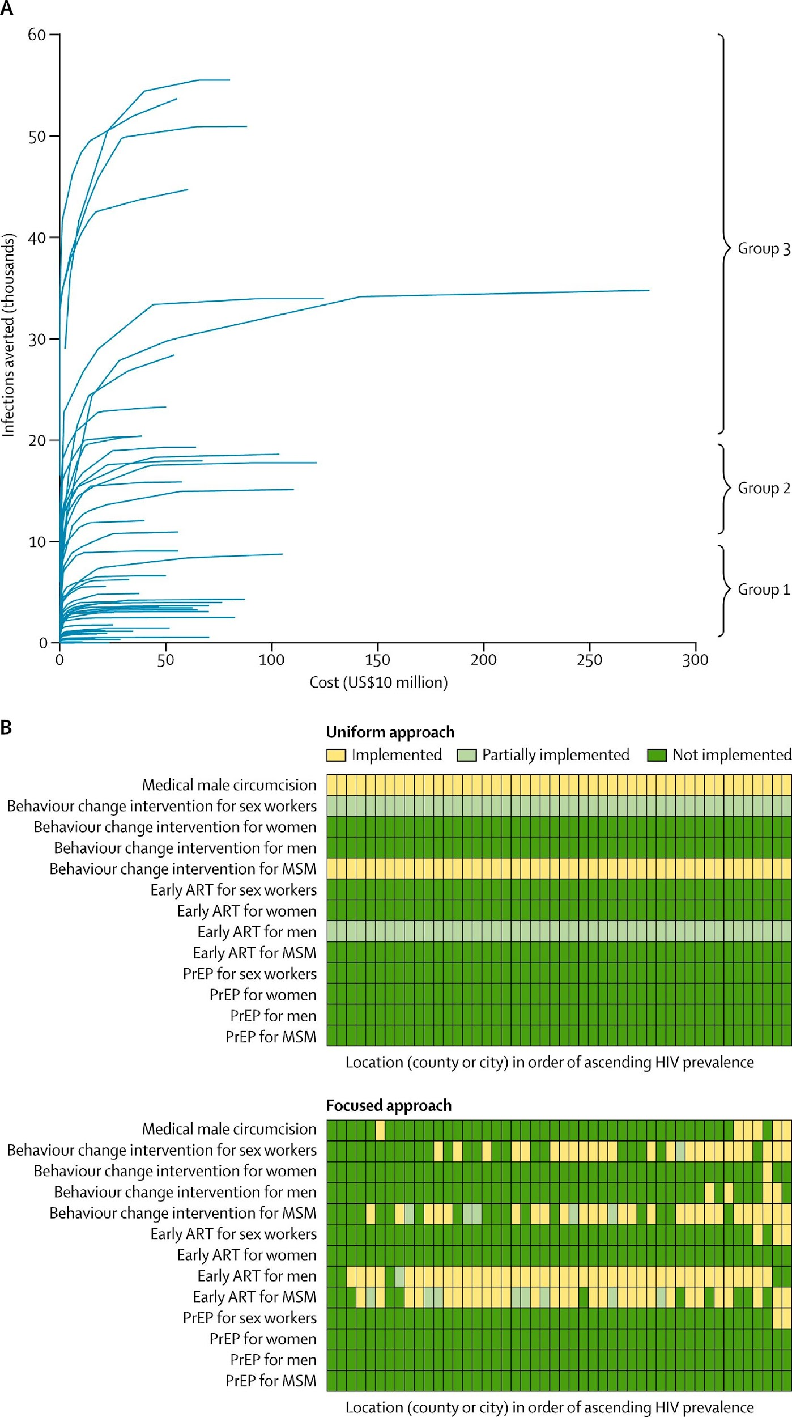
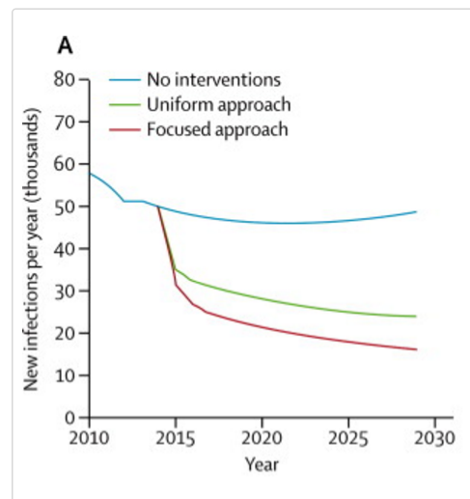
A WIDE VIEW OF GLOBAL HEALTH
Health production functions
Applied to many separate populations
US$600M over 15 years
Source: Anderson et al, Lancet, 2014

Slide 40
OVERVIEW
What is an infectious disease model?
What is a good model?
An overview of themes
Outbreaks
Global Health
Use of genetic data
Discussion

Slide 41
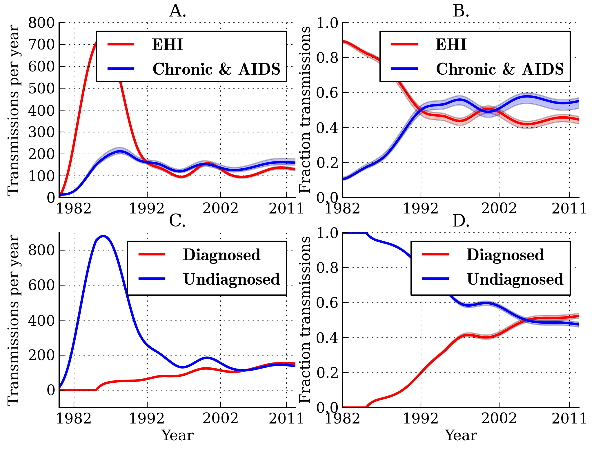
GENETIC DATA ALLOW PRECISE ANALYSIS OF TRANSMISSION
Source: Volz, et al, Plos Med 2013

Slide 42
OVERVIEW
What is an infectious disease model?
What is a good model?
An overview of themes
Outbreaks
Global Health
Use of genetic data
Discussion

Slide 43
OVERVIEW OF THEMES
Questions
Outbreaks
Global health decision making
Population science
Within-host science
Evolution
Methods
Use of genetic data
Use of spatial data
Data synthesis
Pathogens
Big 3
Emerging infections
NTDs
Influenza / Respiratory infections
STIs

Slide 44
OBJECTIVES
Hopefully now, you should be able to:
Explain the key difference between a mathematical transmission model and other statistical models of disease incidence
Describe a framework for the critical evaluation of a evidence derived from a model
Outline the thematic directions of the field in terms of questions addressed and methods used
Describe specific examples of interesting papers from different themes

Slide 45
QUESTIONS?

Slide 46
UNUSED SLIDES

Slide 47


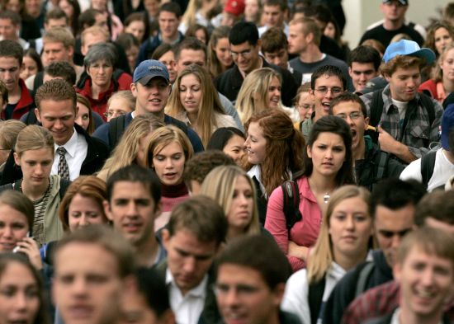

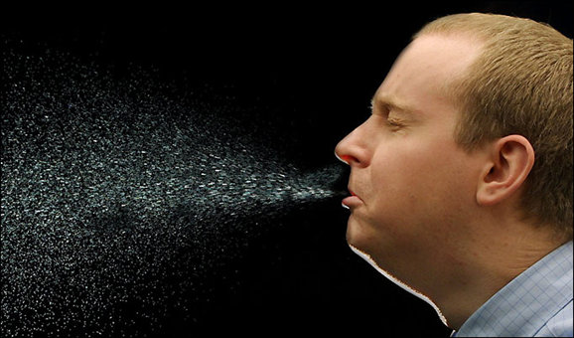
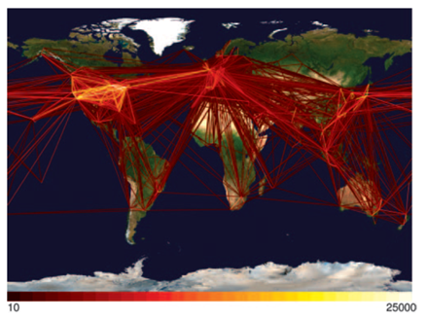
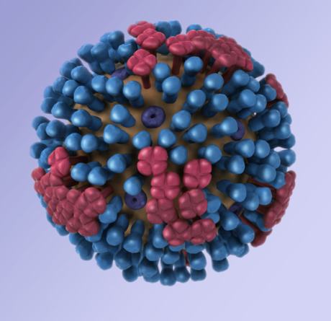
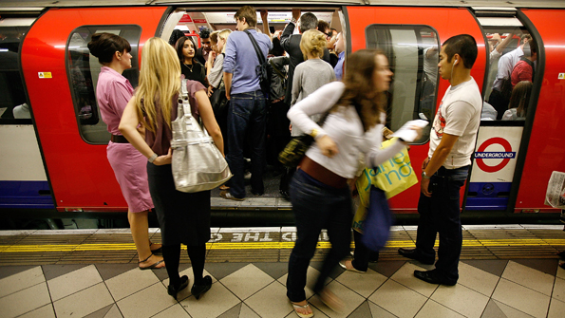
Why important?
Notes:
Relate to Infectious diseases
Using detailed data on how people travel can find the relative risk of infection
It has been shown that global travel networks can anticipate disease spread, what about smaller distances?
Individual patterns of mobility are more of a challenge.
Relative probability of infecting someone in home city, or other city must be related to the probability that they meet. Must be somewhat predictive.
‹#›

Slide 48




Why important?
Notes:
Relate to Infectious diseases
Using detailed data on how people travel can find the relative risk of infection
It has been shown that global travel networks can anticipate disease spread, what about smaller distances?
Individual patterns of mobility are more of a challenge.
Relative probability of infecting someone in home city, or other city must be related to the probability that they meet. Must be somewhat predictive.
‹#›

Slide 49


Mobility models
Notes:
A mobility model is used to determine the relative probability an individual from an origin population travels to each destination population. A way of quantifying the movement patterns. (DO NOT GET INTO FLUX VS MOBILITY HERE)
‹#›

Slide 50


Mobility models
C
B
A
Notes:
A mobility model is used to determine the relative probability an individual from an origin population travels to each destination population. A way of quantifying the movement patterns. (DO NOT GET INTO FLUX VS MOBILITY HERE)
‹#›

Slide 51
Mobility models
E
D
C
B
A
For each origin:
F
Notes:
A mobility model is used to determine the relative probability an individual from an origin population travels to each destination population. A way of quantifying the movement patterns. (DO NOT GET INTO FLUX VS MOBILITY HERE)
‹#›

Slide 52
Gravity model
Notes:
The shorter the distance between two objects and the greater the mass (population) of either/both objects, the greater the gravitational pull between the objects
‹#›

Slide 53
Gravity model
Notes:
The shorter the distance between two objects and the greater the mass (population) of either/both objects, the greater the gravitational pull between the objects
‹#›

Slide 54
Offset gravity model
Notes:
The shorter the distance between two objects and the greater the mass (population) of either/both objects, the greater the gravitational pull between the objects
‹#›

Slide 55
Offset gravity model
Notes:
The shorter the distance between two objects and the greater the mass (population) of either/both objects, the greater the gravitational pull between the objects
‹#›

Slide 56
Radiation model
Notes:
Parameterless
Radiation model describes how likely an individual is to be absorbed by high density locations
‹#›

Slide 57
Radiation model
Notes:
Parameterless
Radiation model describes how likely an individual is to be absorbed by high density locations
‹#›

Slide 58
Radiation model
Notes:
‹#›

Slide 59
Offset radiation model
Notes:
‹#›

Slide 60
Offset radiation model
Notes:
‹#›

Slide 61
Offset radiation model
Notes:
‹#›

Slide 62
Mobility models
Notes:
A mobility model is used to determine the relative probability an individual from an origin population travels to each destination population. A way of quantifying the movement patterns. (DO NOT GET INTO FLUX VS MOBILITY HERE)
‹#›

Slide 63
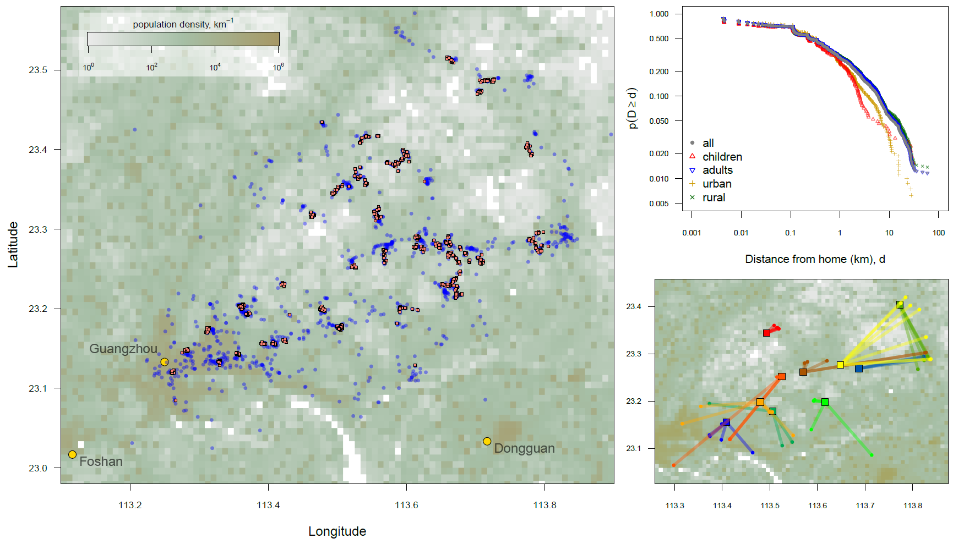
Guangzhou, China
Notes:
But we have much more data – not just one household but lots of households and individuals for this whole area.
‹#›

Slide 64
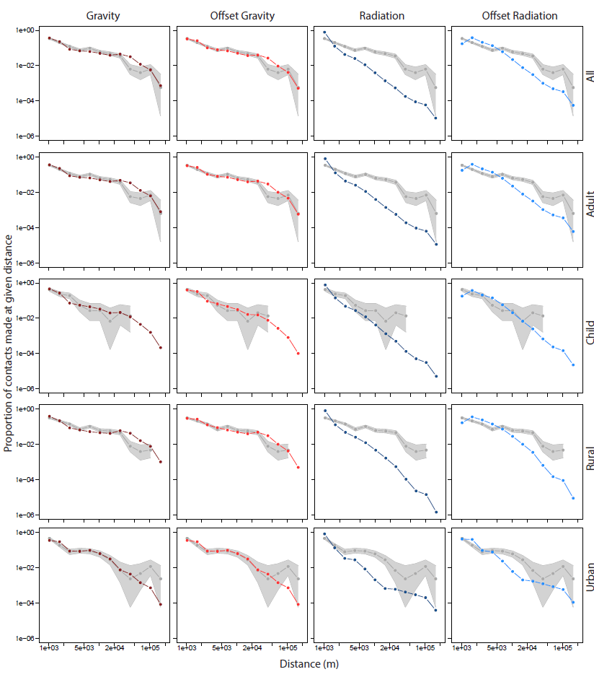
Guangzhou, China
Notes:
‹#›

Slide 65
Guangzhou, China
Notes:
‹#›

Slide 66
Guangzhou, China
Notes:
‹#›

Slide 67
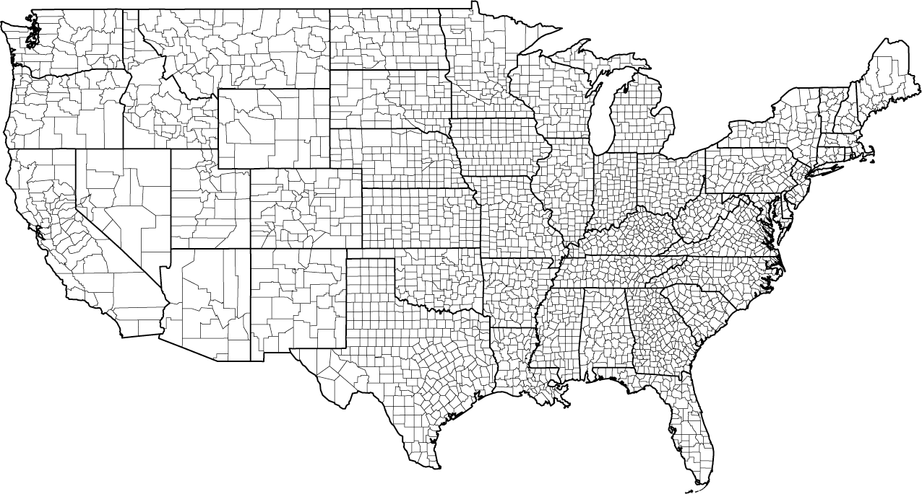
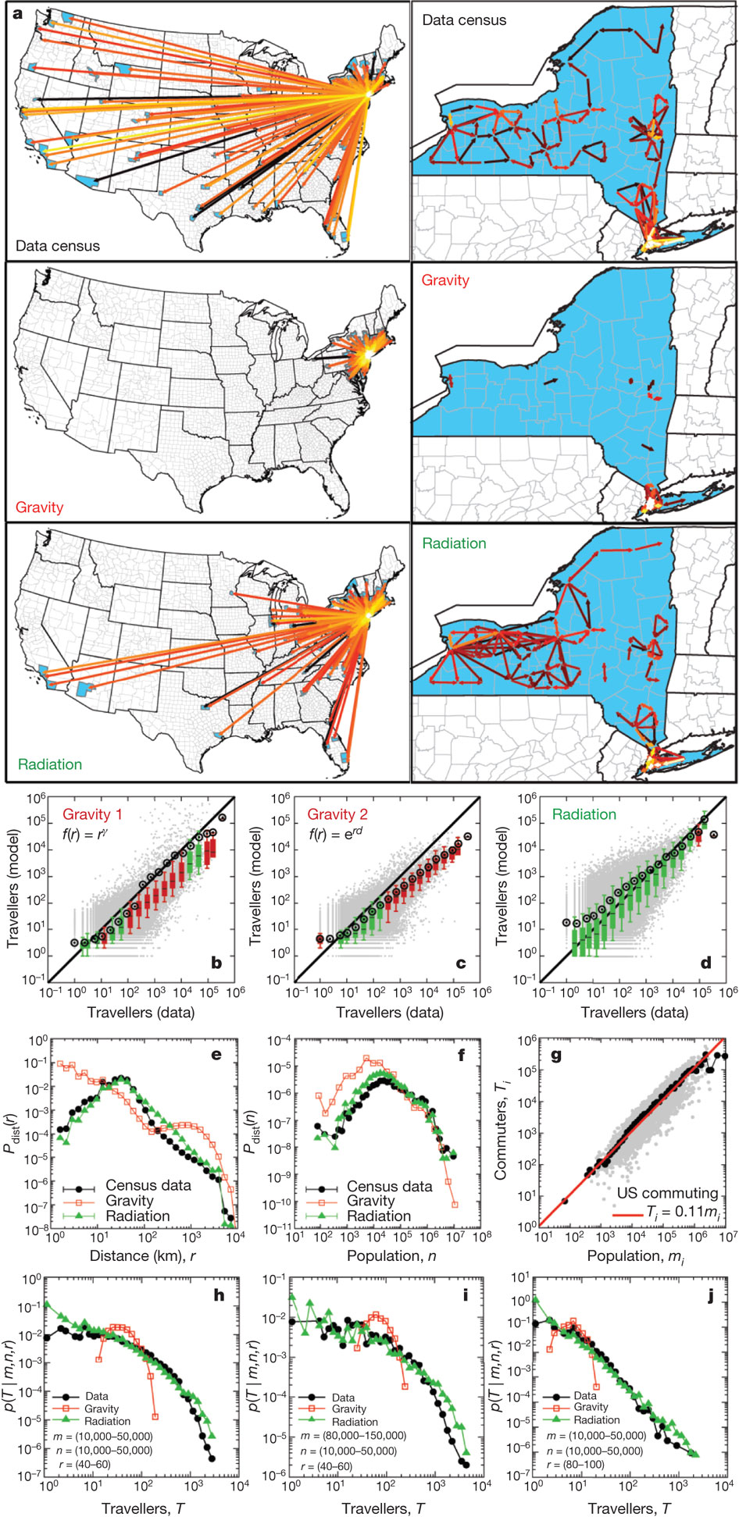
USA commuters
F Simini et al. Nature 000, 1-5 (2012) doi:10.1038/nature10856
Notes:
National mobility fluxes with more than ten travellers originating from New York County (left) and the high intensity fluxes (over 1,100 travellers) within the state of New York (right). Arrows represent commuters fluxes, the colour capturing flux intensity: black, 10 individuals (fluxes below ten travellers are not shown for clarity), white, >10,000 individuals. Reported in US census 2000.
Over 3000 counties, numbers travelling between each county, commuting only.
‹#›

Slide 68
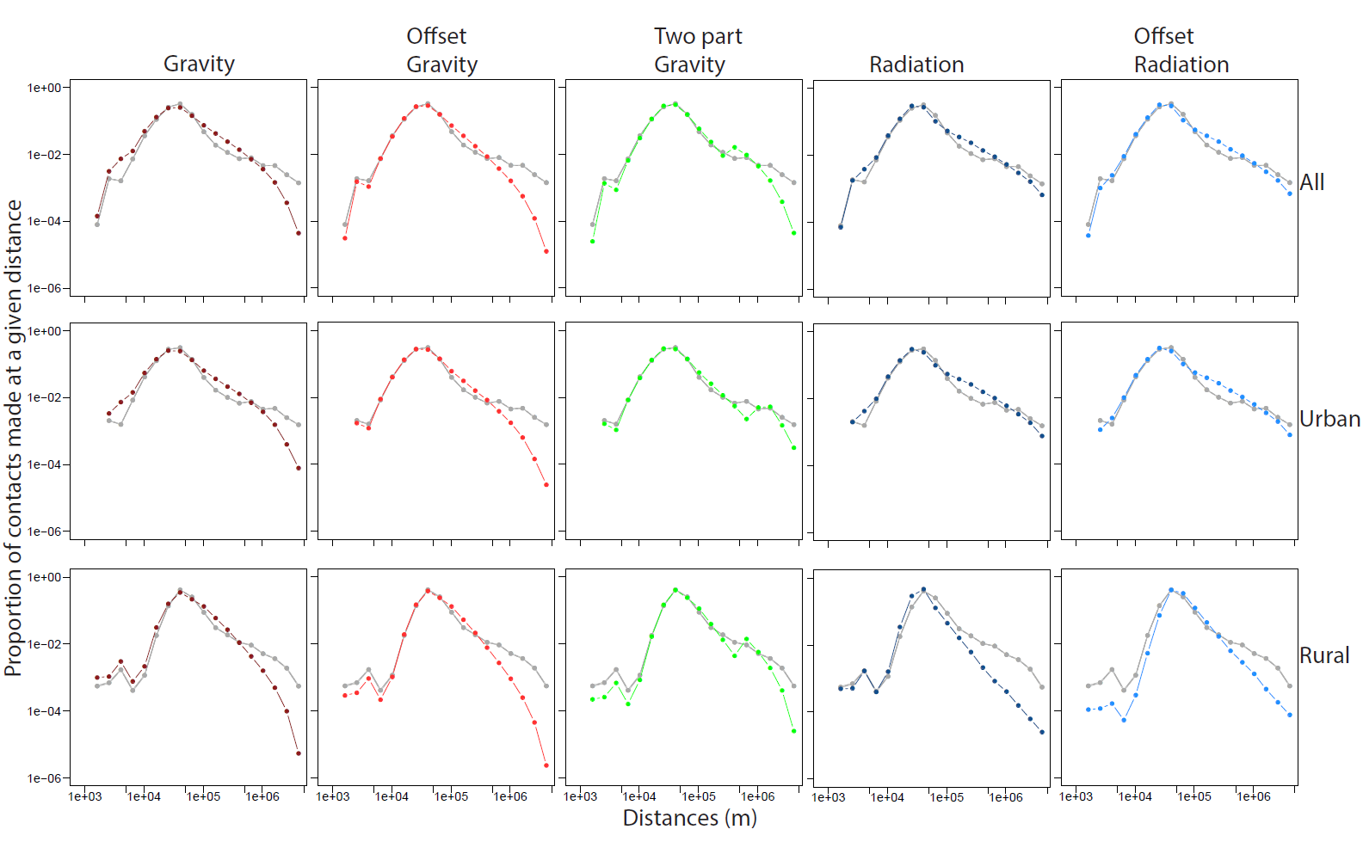
USA commuters
Notes:
National mobility fluxes with more than ten travellers originating from New York County (left) and the high intensity fluxes (over 1,100 travellers) within the state of New York (right). Arrows represent commuters fluxes, the colour capturing flux intensity: black, 10 individuals (fluxes below ten travellers are not shown for clarity), white, >10,000 individuals. Reported in US census 2000.
Over 3000 counties, numbers travelling between each county, commuting only.
‹#›

Slide 69
Conclusions
China:
USA:
Gravity model best describes the mobility.
The distance between locations and the population at those locations can predict the movement between them better than just the population size alone.
Notes:
‹#›

